Slide 1
Layout Lab
Front-End Web Development

Slide 2
Lesson Change Log FEWD 3.1 - 3.2
Below are the specific changes made in this lesson.
Returning Instructor Directions:
Click on the hyperlinks below, and it will direct you to the specific slide.
Copy the entire slide, and paste in your existing curriculum deck.
Font and Pseudo-Selectors - These topics have been been moved to the Flex lesson folder.
Build a Real Website (whole section) - Updated the instructions to include smaller steps such as identifying sections of the site and working through each section one by one.
Share how the lesson went through our Instructor Lesson Exit Ticket - the Curriculum Feedback form: http://ga.co/curriculum-feedback

Slide 3
Pre-Class Materials and Preparation
Review all slides, lab activities, and code-alongs.
There are prompts in the speaker notes with opportunities for instructor customization.
Materials
Reference Code
Starter Code in CodePen
Solution Code in CodePen

Slide 4
Fonts, Pseudo-Selectors, and Layout Lab
Overview
This lesson covers some specific CSS properties and selectors and challenges students to apply their cumulative learnings with a layout lab.
Learning Objectives
In this lesson, students will:
Apply custom fonts to text using CSS.
Use pseudo-selectors to create more specific CSS rules.
Build a real-world HTML/CSS mockup.
Duration: 180 minutes

Slide 5
Suggested Agenda
Time | Activity | Purpose
0:00–0:30 | Q&A Review of CSS So Far | There will likely be questions and a need for a review before jumping in to the ab.
0:30–3:00 | Grid Walk-Through/ Build a Real Website | A major challenge to recreate an entire page. Take it in stages, check in frequently, and demonstrate parts after a while if students get stuck.

Slide 6
Build a Real Website
Layout Lab
Notes:
Duration: 120 minutes

Slide 7
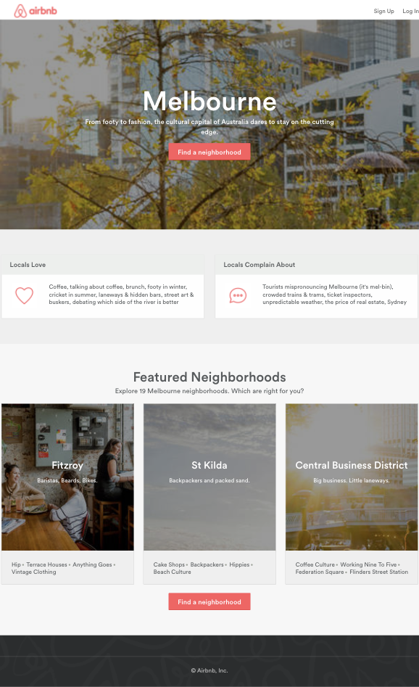
Build a Real Website
120 minutes
You’re going to build the site pictured to the right (deep breath).
This will be difficult but doable. Let’s start it off together and frame out our approach.
Starter code:
https://drive.google.com/drive/folders/1Av21cDcCudU_sQjnU8diWVD9EJ3xiPy_?usp=sharing
Solution code:
https://drive.google.com/drive/folders/1g8ewKDu6HthfQRkngKU4ak9MzJhcR4jK?usp=sharing
Notes:
TEACHING TIPS:
This exercise is timed at two hours and meant to have students both work through previous content and incorporate the newly introduced content. You could adjust this to be a partner or group exercise depending on the students, perhaps allowing students to choose among solo/partner/group formats as they wish.
At this point, this will be HARD for students. The first part of this should be guided:
Help them think about the problem in stages.
Do some wireframe/DOM tree stuff, then move into how to think about HTML, then layout, then styling-up finish work.
Give them a heads up: The dark overlay on the picture requires more than they know how to do (show them pseudo-selectors and the position property). Encourage exploration into Lesson 7, where they will learn how to work with position.
It’s quite likely that many students won’t finish this assignment. You have a choice:
Gauge the class, and if less than 50% don’t finish, turn it into a Homework Assignment 3 for them to finish over the weekend.
Then, show them the overlay as part of Lesson 7. If you have +50% close to finishing, do the overlay as a code-along and wrap up the assignment (the latter path is pretty rare).
Here is a different option for a real build: A prototype from daocloud.com:
Starter code: https://codepen.io/GAmarketing/pen/gOOQGwG
Solution code: https://codepen.io/GAmarketing/pen/BaaGwJV

Slide 8
Identifying Sections of the Site
Let’s identify sections of the site that can be built independent of each other.
We can break down the HTML and CSS that we need, based on the content and layout.
A few hints on some of the advanced pieces of this site:
The hover effect on the Find a Neighborhood button requires pseudo-selectors.
The dark overlay in the picture requires pseudo-selectors and the position property.

Slide 9
The Sections Are...
1
There are five sections on the site:
Header / navigation
Main background image section (with Find a Neighborhood button)
Locals section with two columns
Featured neighborhoods section with three columns
Footer
Each section stacks one on top of the other. They can be built separately, and you should focus on them one by one as you build your site.
2
3
4
5
Notes:
TEACHING TIPS:
At this point, it’s up to you how you want to structure the lab going forward.
One approach would be to give some time for each section, as some sections would require more than others, and then setting aside check-in time to discuss the solution code / CSS concepts for that section.
You can then leave the sections that you don't have time for as homework or extra practice for students over the weekend.
Note: The starter code and HTML are not provided for each section, as this is a good opportunity do a codealong with students to add some HTML section-by-section.

Slide 10

The Header
15 minutes
1
The first section: the header
Header-only solution code
We seem to have two sections of content, one on each side of the page
How can we get this layout in flexbox?
Notes:
TEACHING TIPS:
Do a time check and offer to provide guidance before prompting students to move on to the next section.

Slide 11
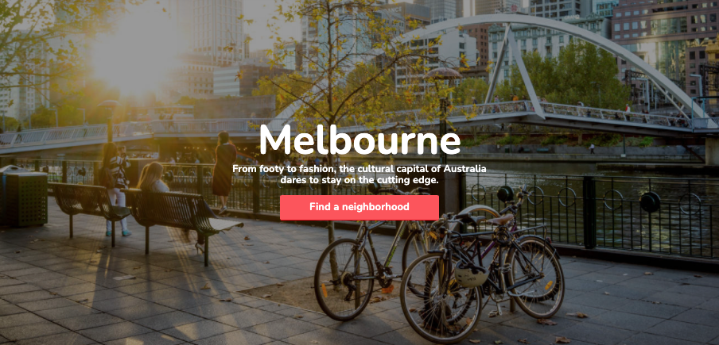
2. The Main Background
30 minutes
The second section: the main background image.
Main background image only solution code
How can we set the image to show up in the background?
Does an element get height from a background image?
How can we center the content inside of the background image?
Bonus: how can we darken the background image?
2
Notes:
TEACHING TIPS:
Do a time check and offer to provide guidance before prompting students to move on to the next section.

Slide 12
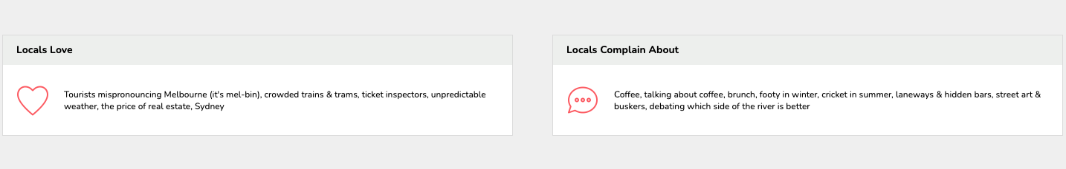
3. Locals Section
30 minutes
The third section: the locals.
Locals-only solution code
How many columns do we see in this section?
Is the layout identical or close to identical in each column?
If so, we can focus on building one column at a time
Once one column is built, we can copy/paste that code to create the other columns (all we have to do is edit the content/HTML)
3
Notes:
TEACHING TIPS:
Do a time check and offer to provide guidance before prompting students to move on to the next section.

Slide 13
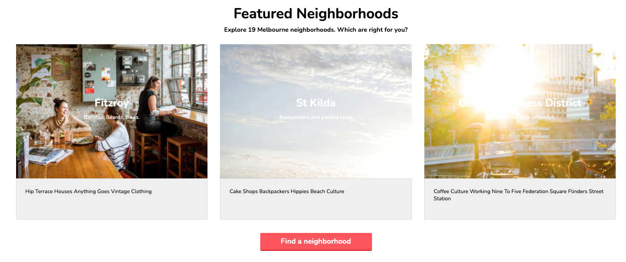
4. Featured Neighborhoods Section
30 minutes
4
The fourth section: the neighborhoods.
Neighborhoods-only solution code
We see a few rows of centered content, and a three column row.
There are a few similar concepts from previous sections:
Each column has similar layout, so we can just focus on building one and then copying that HTML structure to the other columns
Centering content within (or on top of) a background image

Slide 14

5. The Footer
15 minutes
The fifth section: the footer.
Footer-only solution code
5
Notes:
TEACHING TIPS:
Do a quick time check and let students know how much time they have left in the lab.
Depending your students, you can adjust this to be a partner or group exercise or allow students to choose among solo/partner/group formats as they wish.
It’s quite likely that many students won’t finish this assignment. You have a choice:
Gauge the class, and if less than 50% don’t finish, turn it into a Homework Assignment 3 for them to finish over the weekend. Then, show them the overlay as part of Lesson 7.
If you have +50% close to finishing, do the overlay as a code-along and wrap up the assignment (the latter path is pretty rare).

Slide 15
Key Takeaways
For Next Time
Fonts + Layouts = Style Points!
Basics of Responsive Design
Always provide a system font fallback option when using custom fonts.
Pseudo-selectors help target context-specific elements.
Layouts are hard and come with practice.
Complete Homework 3.
Responsive design ensures a good user experience across all device sizes.
Notes:
TEACHING TIPS:
Again, feel free to either extend the “Build a Real Website” exercise into becoming Homework 3 or use the provided Homework 3 assignment deck.

